Slide 1
State Geodetic Administration (SGA)
Croatia
Improved (digital) data and proccesses in Cadastral System
Authors: Benasić, Pupačić, Šantek, Šustić
Presenter: Maja Pupačić
www.dgu.gov.hr

Slide 2
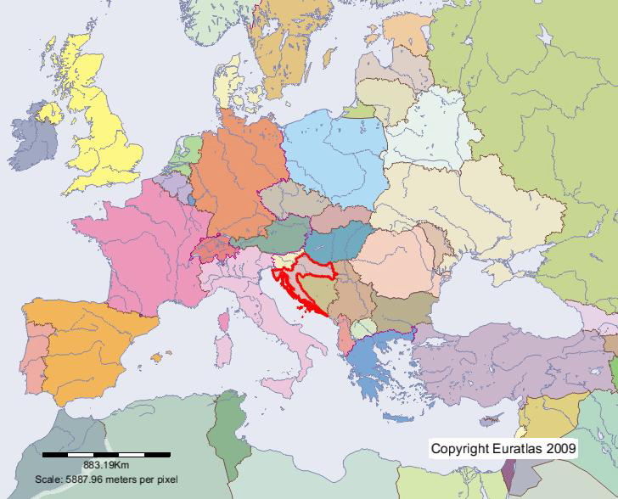
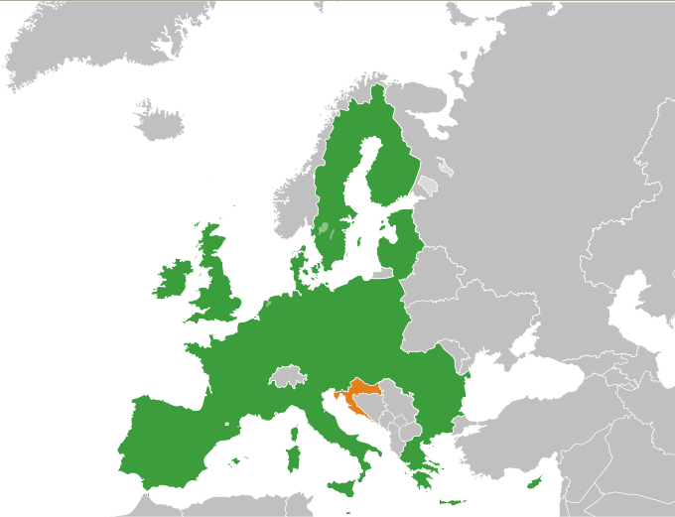
THE REPUBLIC OF CROATIA
Republic with multi-party parliament
[Constitution adopted on 22 December 1990]
56 594 sq km (land surface)
Counties (21), including the City of Zagreb ; Towns (127); Municipalities (429); Settlements (6755)
4.290.612 persons /75,81 persons /sq km,
Croatia is became the 28th member state of the European Union on 1. July 2013.
Notes:
Croatian independace start 1990.

Slide 3
STATE GEODETIC ADMINISTRATION
State Administrative Organization
SGA head office + Regional Cadastral Offices (20) and Branch Offices (92)
City Office for Cadastre and Geodetic Activities (Zagreb)
Cadastral parcels apx. 15 ml
3389 C.M.

Slide 4
POLITICAL & STRATEGIC FRAMEWORK
EUROPEAN CONTEXT - STRATEGY
In the development of the Land Administration System in RoC we were guided by the guidelines imposed by the European and national strategic context as well as the legal framework on both levels. The strategic context which determines the direction of e-government development most is the Digital Agenda for Europe.
EU Action Plans for eGovernment are political instruments for promoting the modernization of public administrations throughout the EU.
  eGovernment Action Plan 2016-2020
  eGovernment Action Plan 2011-2015

Slide 5
POLITICAL & STRATEGIC FRAMEWORK
EUROPEAN CONTEXT – LEGAL FRAMEWORK
Regulation on electronic identification and trust services for electronic transactions in the internal market
Directive on the re-use of public sector information
Directive 2007/2/EC of the EPand of the Council (2007) establishing an Infrastructure for Spatial Information in the European Community (INSPIRE).
General Data Protection Regulation (GDPR) – REGULATION (EU) 2016/679 OF THE EUROPEAN PARLIAMENT AND OF THE COUNCIL
Law on Freedom of Information

Slide 6
POLITICAL & STRATEGIC FRAMEWORK
NATIONAL CONTEXT – STRATEGY
E-Croatia 2020 Strategy
Action Plan for E-government development
Strategy of Public Administration Development in the Republic of Croatia
Strategic plan of the Ministry of Construction and Physical Planning (including SGA strategic plan)
National Spatial Data Infrastructure Strategy
NATIONAL CONTEXT – LEGAL FRAMEWORK
Law on State Survey and Real Property Cadastre
Law on National Spatial Data Infrastructure
Law on National Information Infrastructure

Slide 7


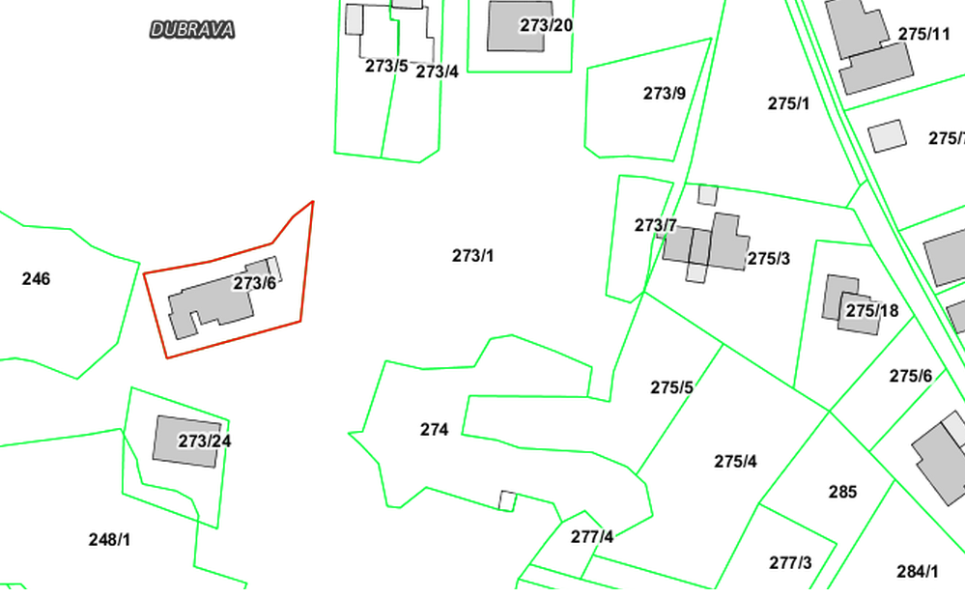
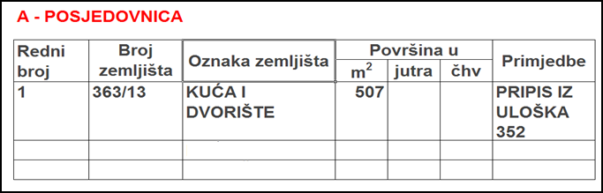
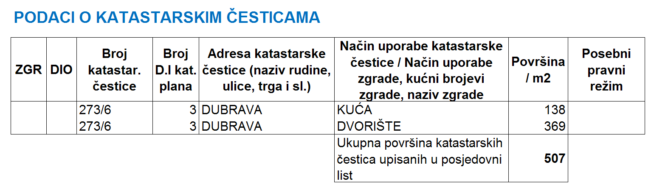
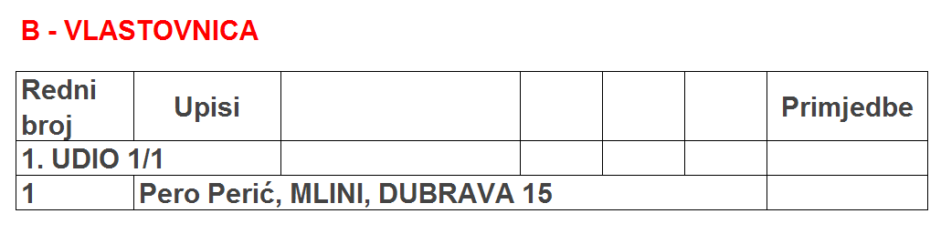
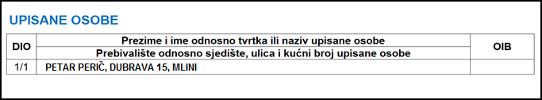
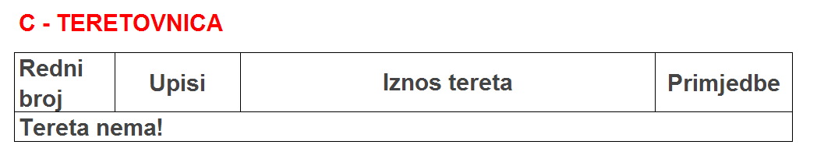
CRO model for registration property and rights is divided between two institutions
Before establishing one common data base
Keep and maintain all cadastral data into 112 cadastral databases Keep and maintain all land registry data into 100 LR databases
KATASTAR
ZEMLJIŠNA KNJIGA
We are aware that the future development of e-Cadastre will primarily depend on the satisfaction of the customers with the services provided, their motivation for using them and their support. In order to fulfil these expectations, the basic precondition is a unified and up-to-date database. This means that data must be organised and accessible in such a way that any kind of query, analysis or statistics can be made at any time and for any purpose and that the data can be provided on a daily basis.
Notes:
Daljnje aktivnosti
7

Slide 8
SGA ACTIVITIES
Since 1999, SGA has conducted many programs standardizing the cadastral system throughout the RoC in organisational and technological terms.
Many projects are implemented in order to raise the data quality and many services have been developed for the data distribution, sharing and exchange.
All preconditions have been met for fully digital business operations:
An unified database and application for keeping and maintaining the land registry and cadastre data has been established. - Real Property Registration and Cadastre Joint Information System (JIS)
Electronic issuing of public deeds (cadastral map copies, possessory sheet transcript/extract and Land Database extract) – One Stop Shop (OSS)
Self-service and free data searching and downloading for the purpose of producing digital geodetic reports - Digital Geodetic Report System (DGRS)
Delivery of actual (surveyed) coordinates in real time - Croatian Positioning System (CROPOS)
Electronic submission of digital geodetic reports (elaborates) – DGRS&OSS
Upcoming legislative changes also go in the direction of the coordinate cadastre, whereby a new step forward is made in perceiving the data quality

Slide 9
SGA ACTIVITIES
2. Legal framework
1. IT solutions
3. Quality of data
4. Education

Slide 10
Real Property Registration and Cadastre Joint Information System (JIS)
One of the most significant and challenging projects that was financed by the WB loan between 2003 and 2016 was the establishment of the JIS
LA institutions decided not to get merged into one institution but opted for a unique Croatian solution of linking the institutions at the level of data and business processes to be maintained according to respective jurisdictions
    A unified, centralised application for all cadastral offices and land registries (unified data model)
    Standardised proceedings with data maintenance (central process-oriented solution)
    IT linking of land registries and cadastral offices (time and financial savings)
    Graphic and alphanumeric data integration
    Integration with other registers and services (PIN, Spatial Units’ Register, e-Citizens, Geoportal, digital archives….)
    Maintenance of harmonised (LDB) and non-harmonised data

Slide 11




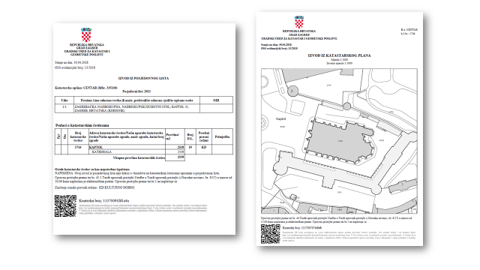
State Geodetic Administration spatial data portal
RSU
JIS -an unified database and application for keeping and maintaining the land registry and cadastre data has been established.
GEOPORTAL - central point of access to SGA spatial data.
JIS
PIN
Export data
Shp, xml
RSU -an unified database and application for keeping and maintaining the spatial data (national, county, city/municipality, cadastral municipality, settlement, street and house number).
Export data
Shp, gml, xml
>JIS data available to citizens through web portal
>Online submission for public documents through private mailbox
>Online paymant
>Digitally signed documents
OSS
Notes:
In order for cutting over to fully digitized system we have to developed a lot of systems and applications so we realized that we will have to develop these systemy in several phases.

Slide 12

State Geodetic Administration spatial data portal
RSU
Allows receiving digitally produced geodetic reports while digital business processes are revised
JIS
ADMINISTRATION WITHOUT PAPER
A2A A2B A2C
PIN
Export data
Shp, xml
Web servis
1,484,479 house numbers – paired with cadastral parcels and allows service issuing of house number certificates
DGRS
Export data
Shp, gml, xml
Web servis
Enables additional electronic business operations to be performed by the SGA and licensed geodetic firms. This system allows all data required for the production of geodetic reports to be captured electronically, reports themselves to be produced in digital form, and submitted to the cadastral office electronically.
OSS
DAS
Allows service viewing of goedetic report Digital Archives – over 12 mil. pages available
Allows issuing digital data to licensed surveyors
Delivering real (surveyed in the field) coordinates to geodetic experts in real time

Slide 13
SGA ACTIVITIES
2. Legal framework
1. IT solutions
3. Quality of data
4. Education

Slide 14
LAW ACTIVITIES (1)
Law on Performing Geodetic Activities - Adopted in 2018
2 Rule Books
Law on State Survey and Real Property Cadastre (new one)
In process – parliamentary procedure - expected by the end of this year
  Rule Book on Determining the Real Costs for using the State Survey and Real Property Cadastre Documentation
  Geodetic Reports Rule Book
  Rule Book on Cartographic Signs
  JOŠ
Law on National Spatial Data Infrastructure - Adopted in 2018
  Spatial Data Infrastructure Act
  2020 National Spatial Data Infrastructure Strategy

Slide 15
SGA ACTIVITIES
2. Legal framework
1. IT solutions
3. Quality of data
4. Education

Slide 16
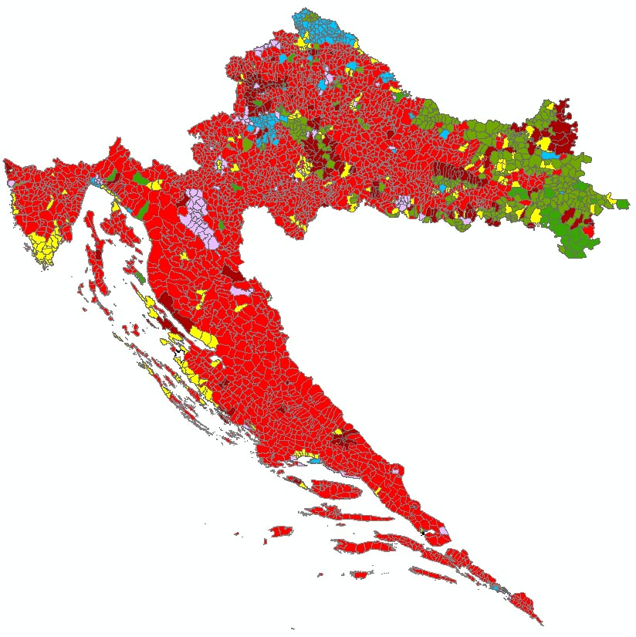
The first land cadastre still in use today was created in the 19th century, at the time when Croatia was part of the Austro-Hungarian Empire.
CADASTRAL DATA
NI
FO
4%
NI/FO
GR
NI/FO/GR
76%
GR/FO
NI/FO/KO
GR/KO
NI/GR
6%
GR/KO/FO
NI/KO
GR/NU
NI/KO/GR
GR/NU
NI/NU
KO
10%
NI/NU/GR
KO/FO
NU
4%
KO/NU
NU/FO
SGA conducts a number of activities for data quality improvement, among which the most extensive and demanding are the new cadastral survey and homogenisation.

Slide 17
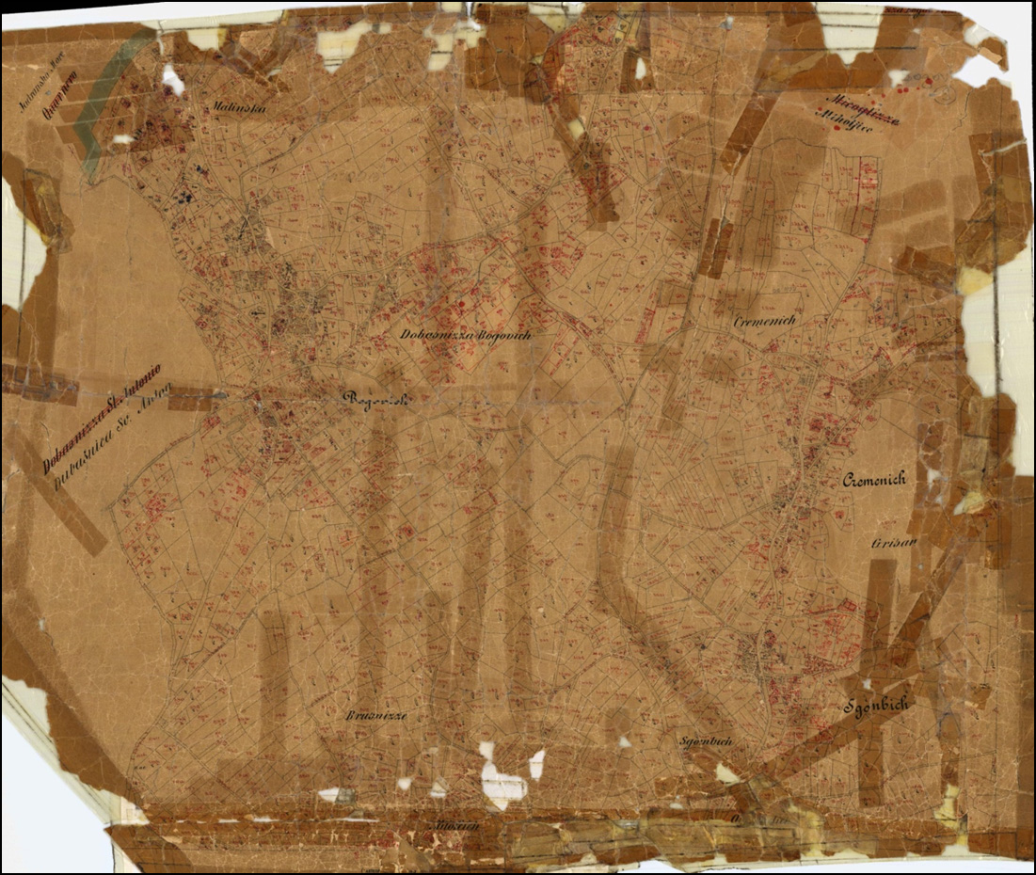
Cadastral municipality Malinska before new cadastral survey
CADASTRAL RESURVEY - method for renewal of cadastral documentation and land register
Notes:
New cadastral surveys aimed at establishing the real property cadastre
Cadastral surveys are undertaken to put real property cadastral documentation in use and establish completely new land registry. Following a cadastral survey, land registry and cadastral data are harmonized 100% on the level of the entire cadastral municipality or a part of it.

Slide 18

New cadastral surveys aimed at establishing the Real Property Cadastre
Cadastral surveys are undertaken to put real property cadastral documentation in use and establish completely new land registry and the land registry and cadastral data for this area are harmonized 100%. (prerequisite for the EU funds, investment)

Slide 19
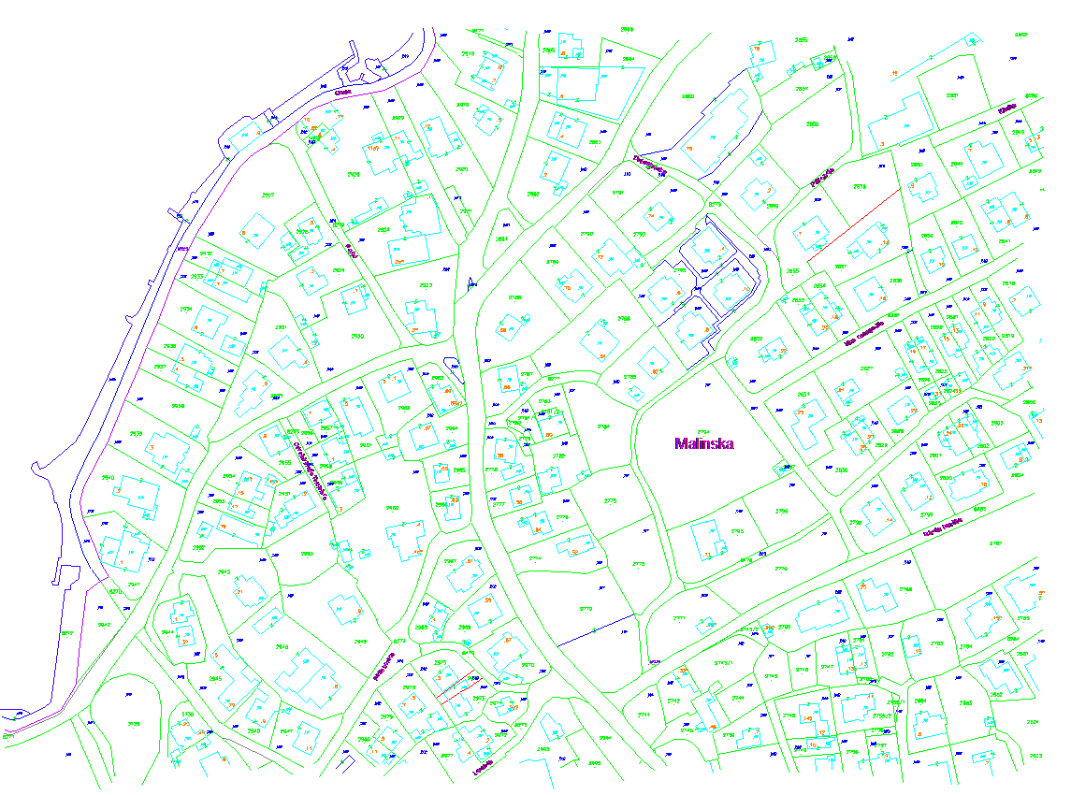
Cadastral municipality Malinska – new cadastral map

Slide 20
HOMOGENISATON
HOMOGENISATON - method for improvement of digital cadastral plan
HOMOGENISATON – is not cadastral resurvey process
HOMOGENISATON – is a technical proces
  geometric and positioning accuracy improvement of the digital cadastral maps (DCM) of the graphical survey
  correct the deformations, inhomogenities and anomalies, and at the same time keep the parts of the cadastral maps that are already mapped by the geodetic records unaltered on their position
  There is still a danger of incompetent use of homogenised data if the expert audience is not educated on how to use homogenised maps. If the homogenised data, although in digital format, does not represent the quality of the digitally surveyed point that was previously marked in the field by the owner it cannot be the basis for transferring digital data in the field (staking, court expert visit, measuring distances in the map for the purpose of project designs) because damage would thus be caused.

Slide 21
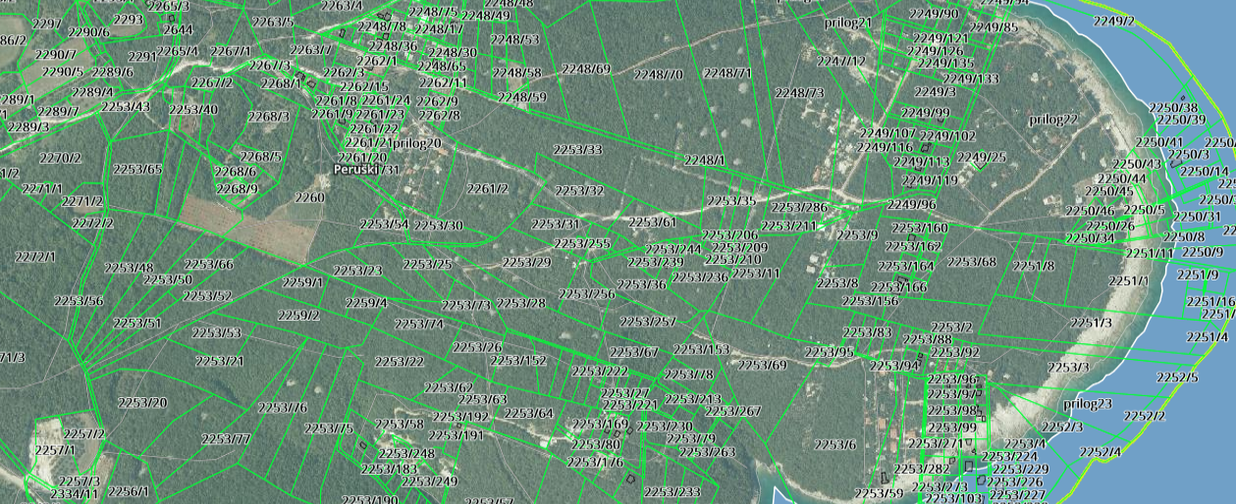
Before homogenisation:
The cadastral maps that the detail is already mapped by the geodetic records
Detail on the cadastral map – position 160 m into the sea
There is no cadastral parcel on the cadastral map (the result of inadequate maintenance)
3
1
2

Slide 22
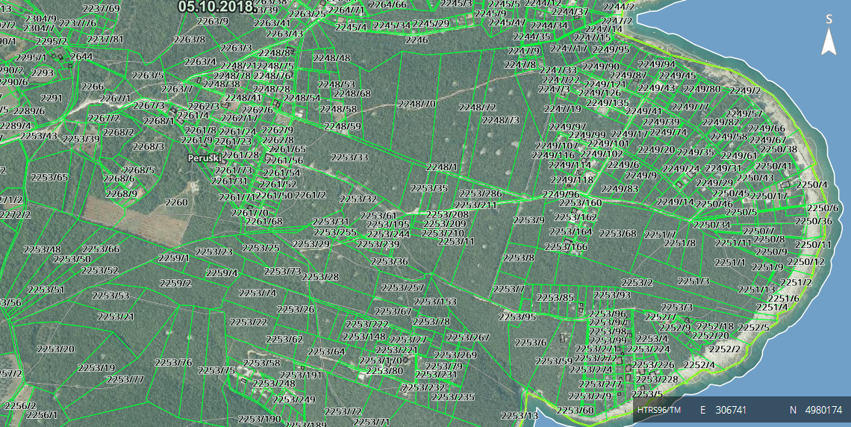
After the process of the homogenisation

Slide 23
SGA ACTIVITIES
2. Legal framework
1. IT solutions
3. Quality of data
4. Education

Slide 24
EDUCATION FOR ADMINISTRATION WITHOUT PAPER
A2A A2B A2C
RSU
Cadastral staff on how to use the JIS application (1,000 employees and continued expert education)
Users via web services
Users via web services
JIS
State Geodetic Administration spatial data portal
Geodetic experts on how to use the SGDE functionality (1,000)
After establishing the paperless administration, it was necessary and mandatory to educate all the system users:
DGRS
Daily and continued support and education for citizens and other State bodies on how to use cadastral data.
Public awareness campaign
OSS
Geodetic experts on how to use the CROPOS system (500 and annual CROPOS conferences)
DAS
Citizens on how to use the OSS functionality (public awareness campaign)
Geodetic experts on how to use the OSS functionality (500)

Slide 25
KEY CHALLENGES
Very little harmonized data between the cadastre and land registration, poor graphical data quality, various business procedures and data definitions.
JIS
Various old applications for maintaining graphical and alphanumerical data which cause development of migration scripts.
Weak institutional capacity and lack of experience to prepare and manage complex IT systems
Difficult to keep experienced domain and IT personnel in the public sector.
JIS complexity were underestimated both by Purchaser and Supplier especially regarding business processes and requirements.
DGRS
Legal changes were ongoing in parallel with the JIS/DGRS development which caused changes in the requirements.
Rengineering of existing business processes (JIS/DGRS) that are too complex

Slide 26
LESSONS LEARNED
Data standardization in defined format and data quality improvement are the long processes and have to start prior to the development of e-bussiness operations that use this data. DATA IS THE MOST IMPORTANT.
Political support and strategic framework on the national and institutional level are very important.
An ICT/e Strategy on the institutional level should be developed on the start of the project and should be updated periodically during next steps; it includes institutional and organizational capacity for the Strategy implementation, methodologies and priorities.
The risk of development of complex IT systems could be reduced by dividing into smaller units and phases that could be contracted separately. On the other hand, this approach requires enhanced coordination of multiple vendors.
IT and domain personnel from institutions should actively participate in all project steps from beginning.
Outside users should be involved in the requirement phase
Education of the all users is necessary and important in the implementation of new IT systems

Slide 27
State Geodetic Administration (SGA),
Croatia
Improved (digital) data and proccesses in Cadastral System
Authors: Benasić, Pupačić, Šantek, Šustić
Presenter: Maja Pupačić
www.dgu.gov.hr

